Slide 1
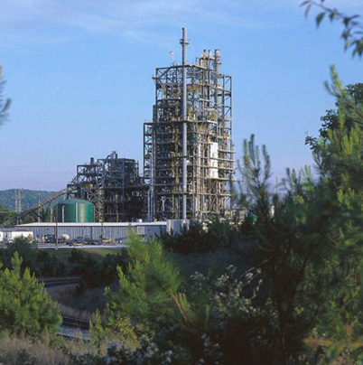

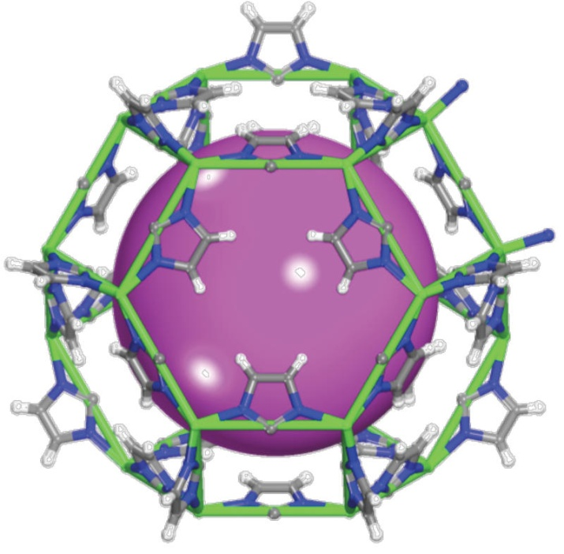
Workshop on Technology Pathways Forward for CCS on Natural Gas Power Systems
United States Energy Association
Mark Ackiewicz
Director, Division of CCS Research
U.S. Department of Energy
April 22, 2014

Slide 2
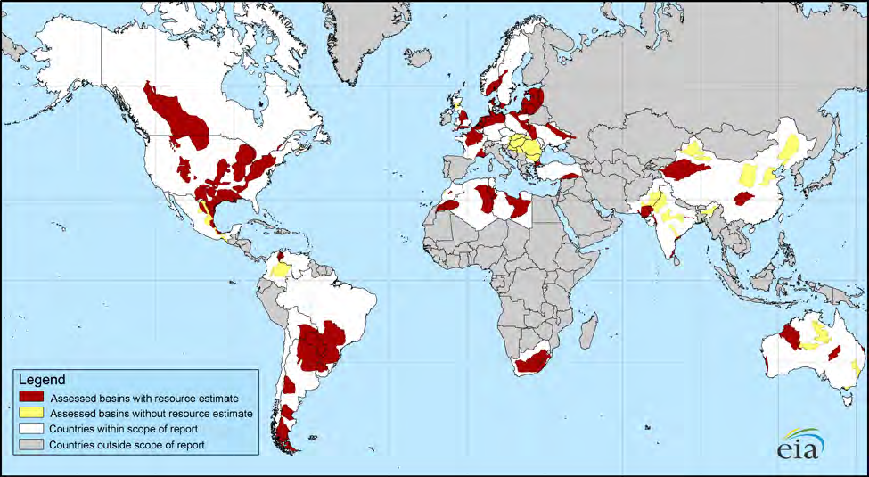
Abundant low-cost gas is changing the world
New EIA-ARI Study:
6,622 Tcf recoverable shale
22,600 Tcf recoverable natural gas
Global shale adds 40%!

Slide 3
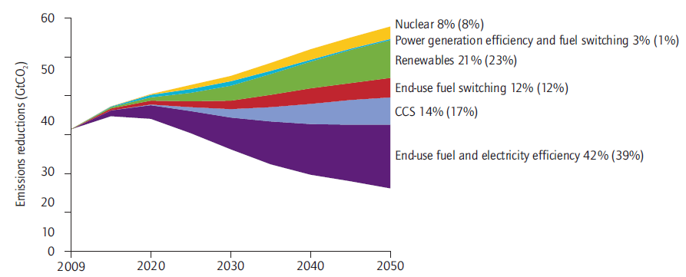
IEA CCS Roadmap 2013: Key Technologies for Reducing Global CO₂ Emissions
Most 2050 climate budgets require CCUS from NatGas power
Source: IEA Roadmap 2013.
Note: Numbers in brackets are shares in 2050. For example, 14% is the share of CCS in cumulative emission reductions through 2050, and 17% is the share of CCS in emission reductions in 2050, compared with the 6DS.
Notes:
ETP2010 identifies the low-carbon energy technologies that can help achieve such a 50% reduction and sets out the policies and other actions that will be necessary.
The most important option in both the short and longer-term is improving energy efficiency. Improved energy efficiency in the end-use sectors accounts for 38% of the total emissions reduction in 2050.
In addition, decarbonizing the power sector will be critical to achieving deep reductions. Under the BLUE Map scenario the emissions intensity of power generation (g/KWh) falls by almost 90% in 2050 in the BLUE Map scenario compared to the Baseline scenario.
[N.B: the relative share contribution of renewables to emission reduction in 2050 is smaller than CCS also because there is already a lot of renewables in the baseline scenario in 2050]

Slide 4
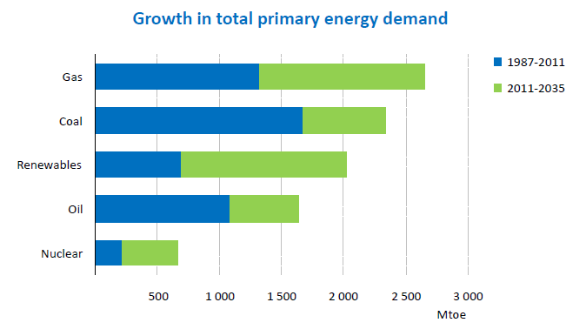
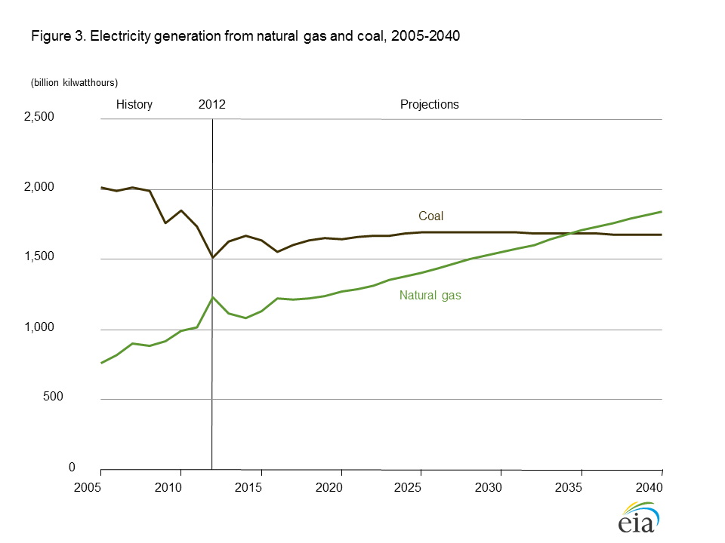
Future of Fossil Energy Demand and Generation
Even with a surge in renewable energy (IEA 2013), fossil fuel use still robust, accounts for 75% in 2035
Natural gas and renewables outpace growth and demand of all other sources world wide
Natural gas is primary source of electricity generation in United States after 2035 (EIA2014)
Fossil Energy remains dominant share (68%) of United States electricity generation in 2040
Source: IEA 2013 World Energy Outlook
Source: EIA 2014 Annual Energy Outlook

Slide 5
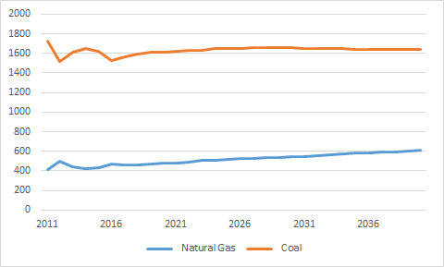
Future CO₂ Emissions from Fossil Energy Electricity Generation
CO2 Emissions from Coal and Natural Gas Generating Units
CO2 emissions are slightly higher in 2040 with increase in total generation capacity, due to fuel switching to natural gas generation
Natural gas allows additional capacity while keeping emissions flat
CCS would be required on significant portion of fleet by 2030 and almost entire fleet by 2050
CO2Emissions MMT/Year
Source: IEA 2013 World Energy Outlook
Source of Data: EIA 2014 Annual Energy Outlook

Slide 6
Fossil Energy FY14 Budget Activities
FY14 Key Activities
  Support to existing portfolio and 18 new capture projects awarded in early FY2014
    2nd generation small-scale pilot, bench, and laboratory projects
  Several projects have/plan to test solvents, sorbents and membranes under natural gas conditions.
    Funded outside of project scope to satisfy industrial partners interests
  Negotiation and Award of Carbon Capture R&D Test Facility
CCS for Natural Gas
  Congressional appropriations provided guidance that research and development could consider natural gas as long as it does not negatively impact efforts to develop technologies for coal.

Slide 7
FY15 Fossil Energy Budget Request
FY15 Key Activities for Carbon Capture
  Large-scale carbon capture pilot facility(ies) 10MW+
  Begin identifying transformational technologies for carbon capture
  Continue support to small-scale pilot projects
Natural Gas CCS Demo
  $25 million requested would be competed to fund work that directly demonstrates technology to capture and store more than 75 percent of the carbon from treated emissions from a natural gas power system.

Slide 8
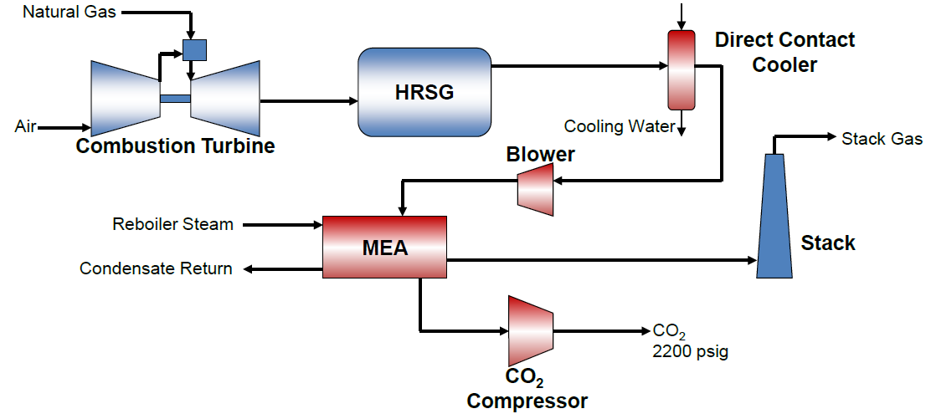
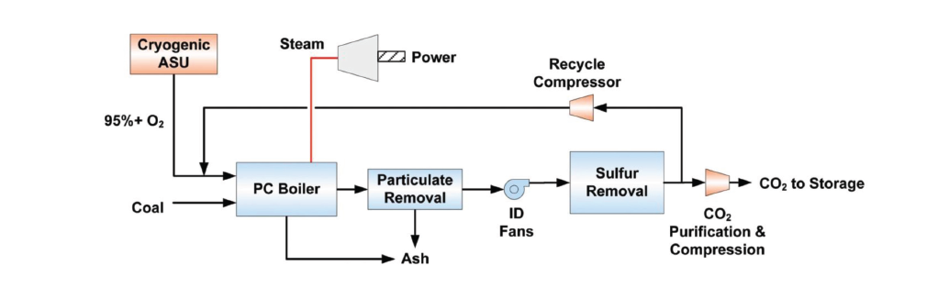
Fossil Energy CO₂ Capture Options
Pulverized Coal (PC)
Post-combustion
Natural Gas Combined Cycle (NGCC)
Post-combustion
PC Oxy-Combustion
Gasification (IGCC)
Pre-combustion
Source: Cost and Performance Baseline for Fossil Energy Power Plants study, Volume 1: Bituminous Coal and Natural Gas to Electricity; NETL, May 2007.

Slide 9
Development Trajectories for Achieving Goals
Illustrative Example: Post-Combustion Capture
Target Line to
Achieve DOE Goals - $40/tonne
Bounded Pathways
to Achieving Target
Reference
new PC plant (amine)
B'
Capital and O&M Cost Reduction
Goal Trajectory
2nd Generation
Feasible Region
Transformational
B''
Indirect
Cost Reduction
Financial costs
Thermodynamic costs
Notes:
The goal for 2nd generation technologies are looking to capture carbon at $40 per tonne
Capture costs are determine by a combination of capital and operating costs (i.e. energy requirements for regeneration)
There are limits to how low each of these costs can be.
But there are substantial opportunities where transformational technologies will be able to significantly reduce these costs below our current goal for 2nd generation technologies.
As we commercialize 2nd generation technologies we are in the process of seeking these transformational ideas which will be needed for all fossil fuel power generation, including natural gas combined cycle plants.

Slide 10
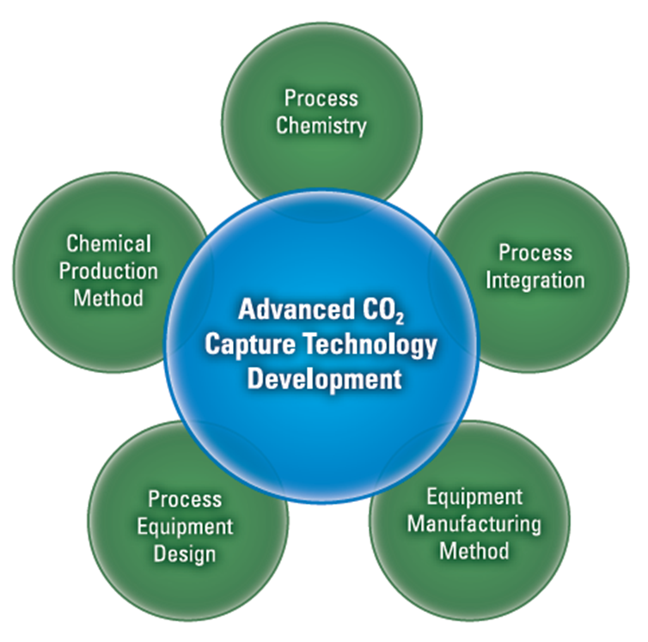
Example: Breakthroughs Needed in Multiple Areas
Current Advanced Post-Combustion Portfolio
URS/U TX Austin
University of Illinois
B&W
Linde
TDA
ADA
SRI
B&W
Linde
URS/Texas
Linde
Kentucky
Southern Co.
MTR
Neumann
TDA
ADA
SRI
Southern Co.
MTR
MTR
ADA
Neumann
10
Notes:
This diagram illustrates some of the stakeholders involved in the program.
But this does not include other major participants from industry such as AEP, Duke, EPRI, several national labs, and other organizations that are activity involved in the program projects.

Slide 11
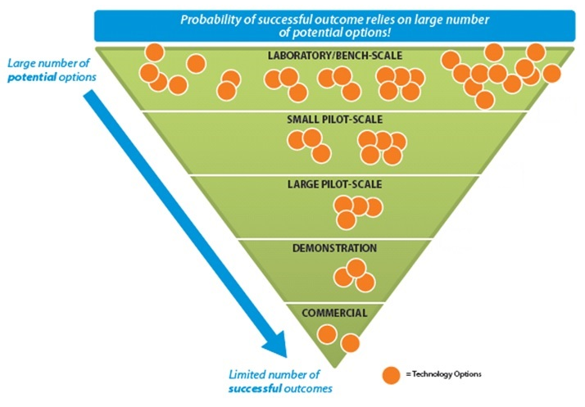
Pathway for Technology Commercialization
TRL 2 Successes from FWP, SBIR/STTR, ARPA-E
Scope of
Capture Program
“Valley of Death” for Technologies
Transfer to Office of Major Demonstrations
Notes:
2nd gen technologies – Ready fo scale up to large scale pilots in 2015/16
Transformational Technologies – Need to begin adding transformational technologies to the R&D portfolio starting in 2015

Slide 12
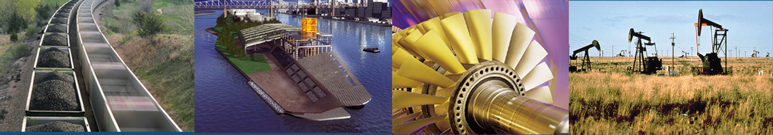
Questions?

Slide 13
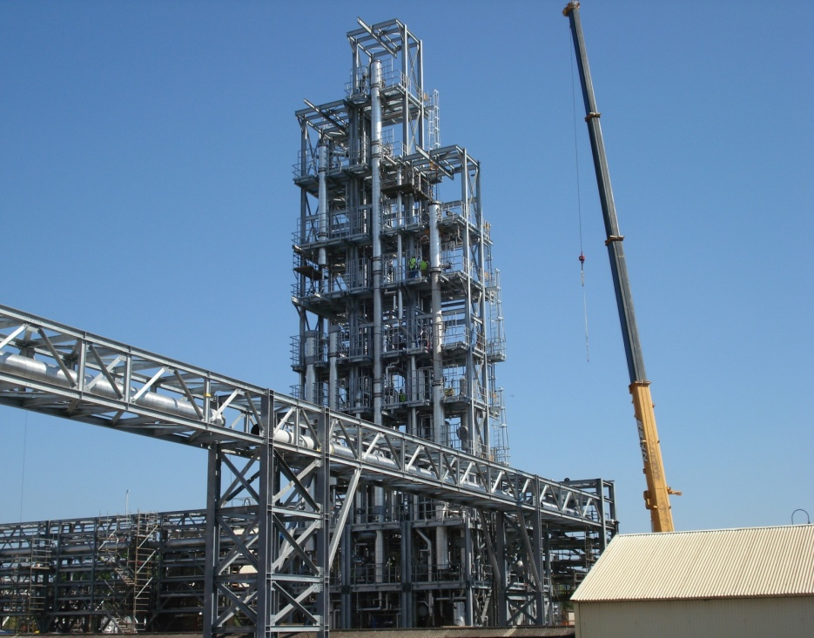
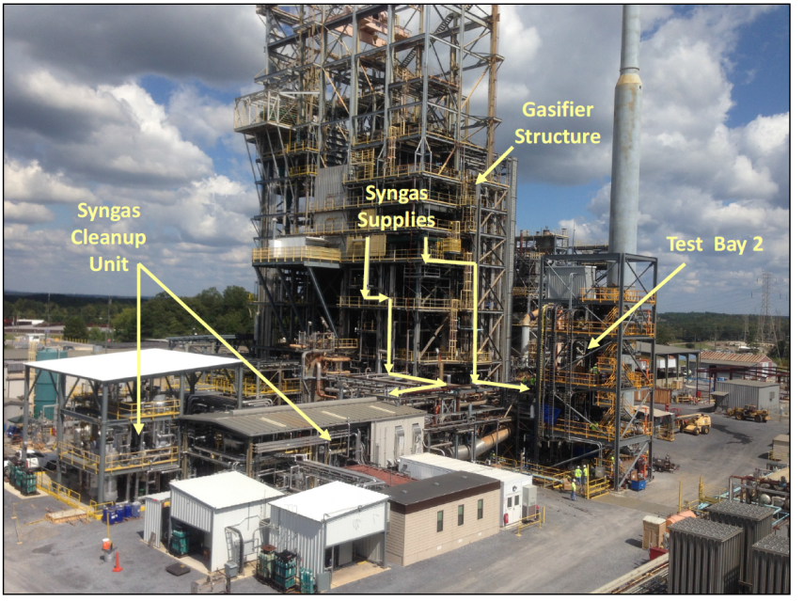
National Carbon Capture Center (NCCC)
Goal
Develop technologies under realistic conditions that will reduce the cost of advanced coal-fueled power plants with CO₂ capture
Advantages
National resource for industry and academia to validate performance and operations of advanced capture
Consistent testing procedures and data collection allow comparison
Stellar safety and environmental record
Status
Over 20 technologies tested from laboratory to small scale pilot
Hundreds of technologies screened
0.5 Mwe
(10 tpd CO₂)
Pilot Solvent Test Unit (PSTU)
Pre-combustion Capture Center

Slide 14
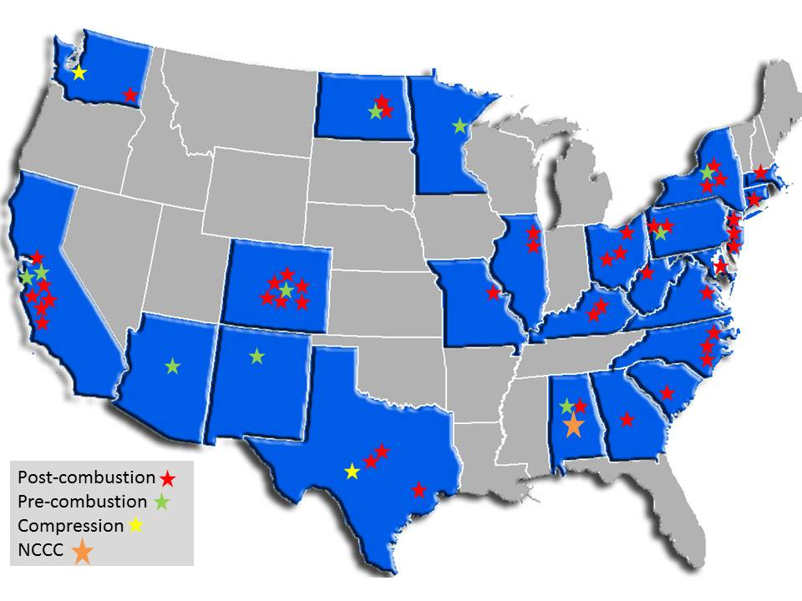
DOE Carbon Capture Projects - Coal
    70 R&D projects
    $650M portfolio
    23% cost share
Notes:
The program has approximately 70 active R&D projects in 24 states.

Slide 15
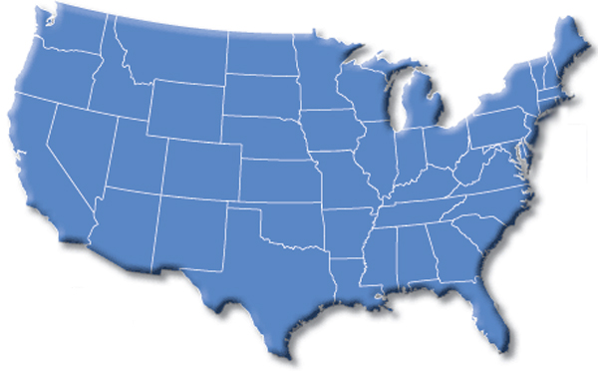
DOE CCUS Demonstration Projects
Focus – Large-scale commercial demonstration of CCUS integrated with coal power generation and industrial sources.
Archer Daniels Midland
CO₂ Capture from Ethanol w/ saline storage
$141 Million - DOE
$208 Million - Total
Hydrogen Energy California
IGCC with EOR
$408 Million - DOE
$4.0 Billion - Total
FutureGen 2.0
Oxy-combustion with CO₂ capture
and saline storage
$1.0 Billion - DOE
$1.3 Billion - Total
Summit Texas Clean Energy
IGCC with EOR
$450 Million - DOE
$1.7 Billion - Total
Southern Company Services
IGCC-Transport Gasifier w/CO2 pipeline
$270 Million - DOE
$2.67 Billion - Total
NRG Energy
Post Combustion with CO₂ Capture with EOR
$167 Million – DOE
$339 Million - Total
Leucadia
CO₂ Capture from Methanol with EOR
$261 Million - DOE
$436 Million - Total
FutureGen
Air Products
CO₂ Capture from Steam Methane Reformers with EOR
$284 Million - DOE
$431 Million - Total
CCPI
ICCS (Area I)
Notes:
DOE is also supporting nearly $10 billion worth of demonstration projects through base program funding and ARRA funding to demonstrate large-scale integrated CCS projects in a number of industries, utilizing a number of different technologies to help with the initial deployment of CCUS at scale and to provide data, knowledge, and experience. Additionally, the Demonstration Program will offer a way to test new technologies being developed in the R&D program as they mature.
The DOE is funding, in partnership with industry, several large-scale projects to demonstrate first-generation capture technologies and carbon utilization and storage. These first-gen capture technologies are currently available for various industries but have not been demonstrated for coal-fired power plants at scale.
8 active projects
7 commercial
5 power plants, 3 industrial
3 IGCC, 4 post-processing (1 post-combustion), 1 oxycombustion
Feedstock: 4 coal, 1 petroleum coke, 1 coal/coke, 1 natural gas, 1 ethanol
2 polygeneration (urea)
Storage: 6 EOR, 2 saline formations
The next slide will show some of the details of these projects.

Slide 16
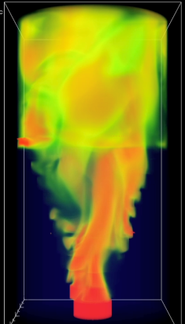
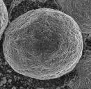
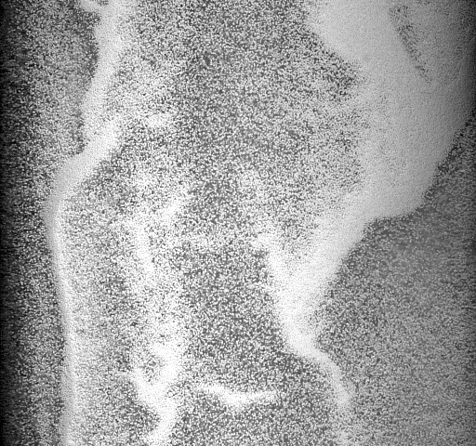
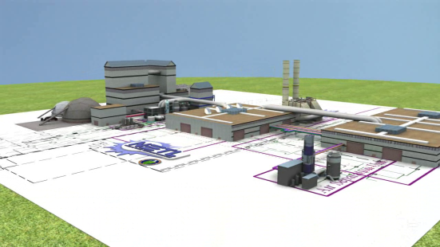

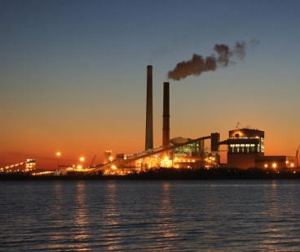















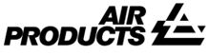







Carbon Capture Simulation Initiative (CCSI)
Identify
promising
concepts
Reduce the time
for design & troubleshooting
Quantify the technical risk, to enable reaching larger scales, earlier
Stabilize the cost during commercial deployment
National Labs
Academia
Industry
1-31-2012
Essential for accelerating commercial deployment

