Slide 1

Hollow Fiber Membrane Contactors
For CCS on Natural Gas Power Systems
WORKSHOP ON TECHNOLOGY PATHWAYS FORWARD FOR
CARBON CAPTURE & STORAGE ON NATURAL GAS POWER SYSTEMS
Howard Meyer, R&D Director
April 22, 2014, Washington, DC

Slide 2
Introduction
GTI and PoroGen Inc. have teamed to develop a hollow fiber membrane contactor (HFMC) technology using PoroGen’s patented fiber manufacturing technology and knowhow
CO₂ removal applications for flue gas and natural gas
HFMC for both absorber and regenerator
Advantages to be confirmed are lower capital and operating costs, lower weight, smaller size systems, no flooding, high turndown-ratio, modularity, shop fabrication for any capacity, insensitivity to motion for offshore operations

Slide 3


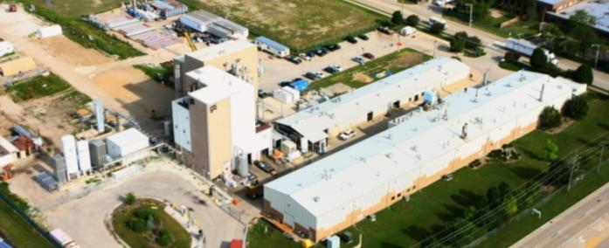
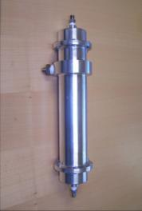
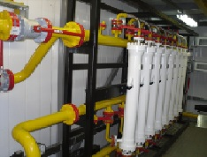
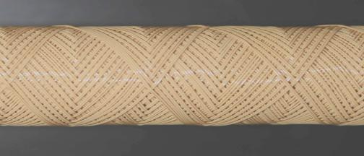
Introduction to GTI and PoroGen
Not-for-profit research company, providing energy and natural gas solutions to the industry since 1941
Facilities
  18 acre campus near Chicago
  250 staff
Materials technology company commercially manufacturing products from high performance plastic PEEK (poly (ether ether ketone))
Products ranging from membrane separation filters to heat transfer devices
PEEK Fiber +
Cartridge
+ Module =
Separation system
Energy & Environmental Technology Center

Slide 4
Natural Gas Flue Gas has Lower CO₂ and Higher O₂ than Coal
 | PC Supercritical Power Plant | NGCC Power Plant
Plant Size, MW_{e} | 550 | 474
Flue Gas Rate, kgmole/hr | 102,548 | 113,831
CO₂, % | 13.5 | 4
H₂O, % | 15 | 9
O₂, % | 2 | 12
N₂, % | 68.5 | 74
CO₂ Captured, Tonne/hr | 550 | 183
Cost and Performance Baseline for Fossil Energy Plants Volume 1: Bituminous Coal and Natural Gas to Electricity Revision 2a, September 2013, DOE/NETL-2010/1397

Slide 5
Impact of CCS on NGCC
Plant capital cost is ~ doubled
Cost of electricity increased by ~41-53%
Efficiency reduced by 14-16%
Plant net output reduced by 14-16%
Plant water use increases by 23-86%
Cost of CO₂ capture is $66-99/ton CO₂ avoided
Plant land area available at plant is limited
Technical and Regulatory Analysis of Adding CCS to NGCC Power Plants in California, Prepared for Southern California Edison Company by CH2M Hill, Nov. 2010

Slide 6
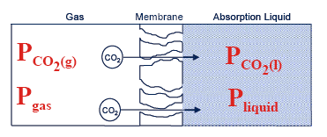
Basic Principles of HFMC Contactor
Membrane mass transfer principle
Porous, hollow fiber membrane
Unique membrane material , PEEK
Membrane matrix filled with gas
Mass transfer by diffusion reaction
Driving force: difference in partial pressures of component to be removed/absorbed (PCO₂(g)>PCO₂(l))
Liquid on one side, gas on the other side of the membrane
Pressure difference between shell and tube side can be almost zero
(P_{l}≥P_{g}), i.e. the mass transfer is not pressure driven

Slide 7
HFMC Technology Description
Notes:
This allows for countercurrent flow between gas and liquid

Slide 8
Mass Transfer Performance
Comparison to Other Contacting Technologies
Gas‐liquid contactor | Specific surface area, (m²/m³) | Volumetric mass transfer coefficient, (sec)⁻¹
Packed column (Countercurrent) | 10 – 350 | 0.0004 – 0.07
Bubble column (Agitated) | 100 – 2,000 | 0.003 – 0.04
Spray column | 10 – 400 | 0.0007 – 0.075
Membrane contactor | 100 – 7,000 | 0.3 – 4.0

Slide 9
Pilot Test of a Nanoporous, Super-hydrophobic Membrane Contactor Process for Post-combustion CO₂ Capture
DOE Contract No. DE-FE0012829

Slide 10
Bench-scale Technical Goals Achieved
Parameters | Goal | Achievement
CO₂ removal in one stage | ≥ 90% | 90%
Gas side ΔP, psi | ≤ 2 | 1.6
Mass transfer coefficient,(sec)⁻¹ | ≥ 1 | 1.7
CO₂ purity | ≥ 95% | 97%
Continuous operation time in integrated absorber/desorber | ≥ 100 h | 104 h with >90% CO₂ removal
Mass transfer coefficient of the 4” 2,000 GPU module in the field | >1.0 (sec)⁻¹ | 1.2 (sec)⁻¹

Slide 11
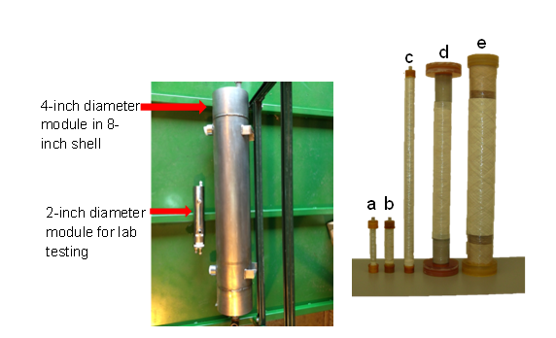
Module Scale Up

Slide 12
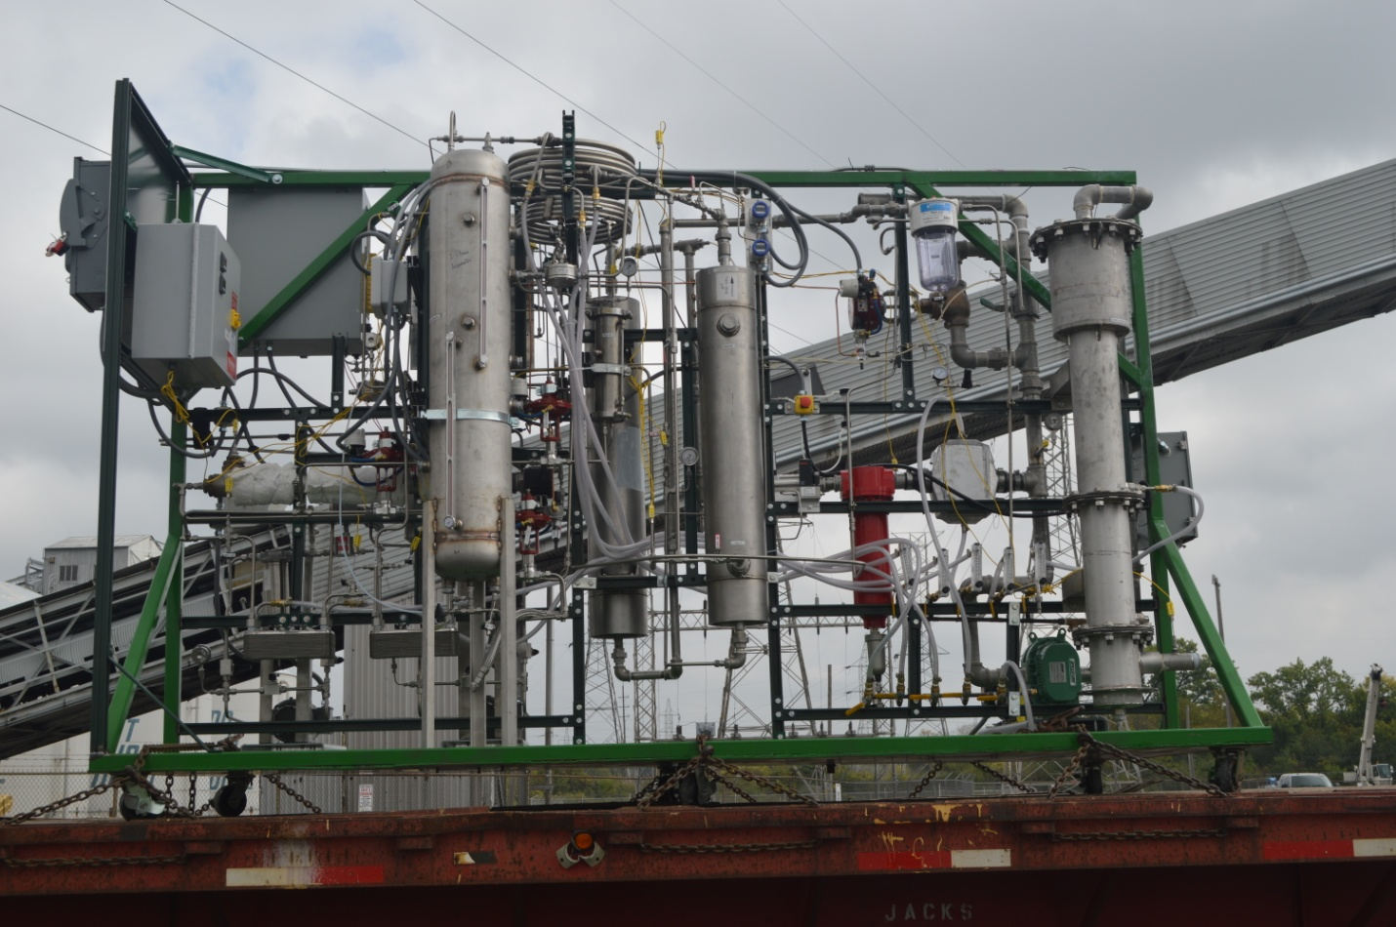
Field Experiment Testing Rig

Slide 13
Flue Gas Composition
Element | Concentration
CO₂ | 7.4-9.6 vol%
NO_{x} | 40-60 ppmv
SO₂ | 0.4-0.6 ppmv
CO | 100-600 ppmv
O₂ | 8.5-11 vol%
Balance: N₂ , water vapor and trace elements
  Slipstream removing ~ 100 - 135 lb/day CO₂
  Modules with ~100 ft² of area
  Tests of aMDEA and H3-1 (Hitachi solvent)

Slide 14
Integrated Flue Gas Carbon Capture Field Experiment
Attained target CO₂ removal (> 90%) with both solvents
200 - 300 hours of operation logged
Presence of SO₂ (up to ~500 ppmv) did not affect CO₂ removal
Mass transfer coefficients >1 s⁻¹ obtained (with 2,000 GPU module) [conventional contactors: 0.0004-0.075 (sec)⁻¹]
H3-1 has better mass transfer coefficient by ~17%

Slide 15
Slipstream Project Objectives and Goal
Objectives:
  Build a 1 MW_{e} equivalent pilot-scale CO₂ capture system (20 ton/day) using PEEK hollow fibers in a membrane contactor and conduct tests on flue gas at the NCCC
  Demonstrate a continuous, steady-state operation for a minimum of two months
  Gather data necessary for process scale-up
Goal
  Achieve DOE’s Carbon Capture performance goal of 90% CO₂ capture rate with 95% CO₂ purity at a cost of $40/tonne of CO₂ captured by 2025
NCCC= National Carbon Capture Center (Southern Company, Wilsonville, AL)

Slide 16
Timeline and scope
Oct, 2013
BP1: Design of the 1 MW equivalent scale system
Oct 2014
BP2: Procurement
of parts, and
construction
Oct 2015
BP3: System installation and shakedown
Oct 2016
BP4: Parametric and continuous tests
Sep 2017

Slide 17
Anticipated Slipstream Feed Conditions at NCCC
Parameter | Condition
Capacity, MW_{e} | 1
CO₂ Capture, ton/day | 20
Pressure | ~ atmospheric pressure
Temperature | ~ 40 °C (100 °F)
Gas composition | CO₂ concentration: ~13 vol%
Water vapor in feed stream | Fully saturated
Contaminant levels | SO₂ level: 20-30 ppm or ~1 ppm

Slide 18
PC Process Flow Diagram

Slide 19
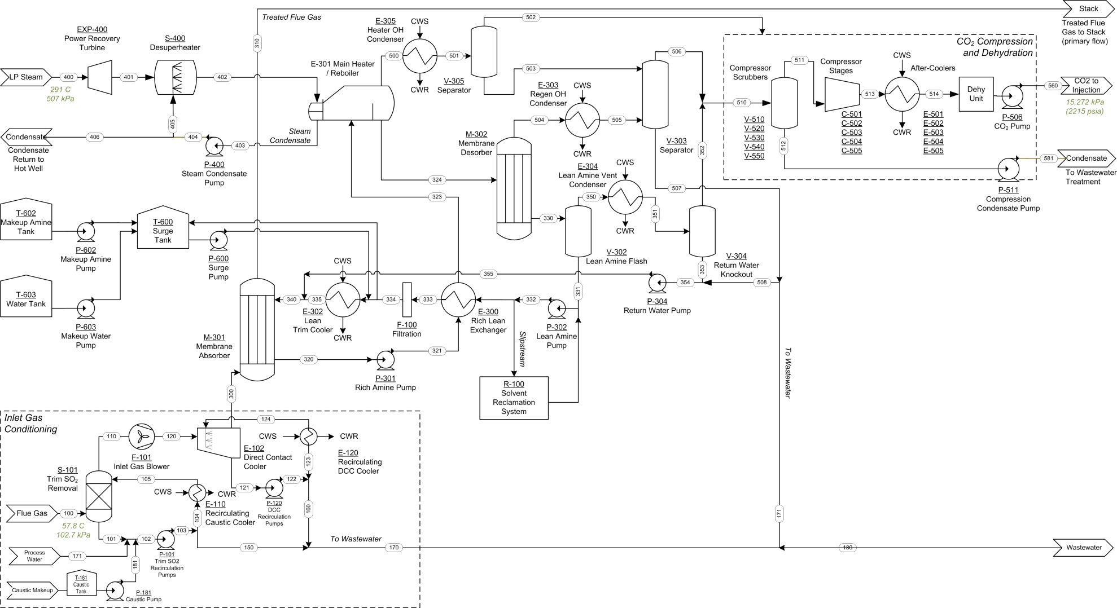
Capture System PFD

Slide 20
Plant Efficiency Summary
Item | Unit | Case 11 (no capture) | Case 12 (Econ-amine™) | GTI HFC - H3-1
HHV Thermal Input | kWh_{th} | 1,409,162 | 1,934,519 | 1,816,984
Net Plant HHV Effic. | % | 39.3 | 28.4 | 30.3
Net Plant HHV Heat Rate | Btu/ kWh | 8,687 | 12,002 | 11,271
COE - Total | mills/ kWh | 81 | 147 | 130-135
Increase in COE - Total | % | - | 82 | 59-67
Cost of CO₂ Capture - Total | $/tonne | - | 66 | 50-57

Slide 21
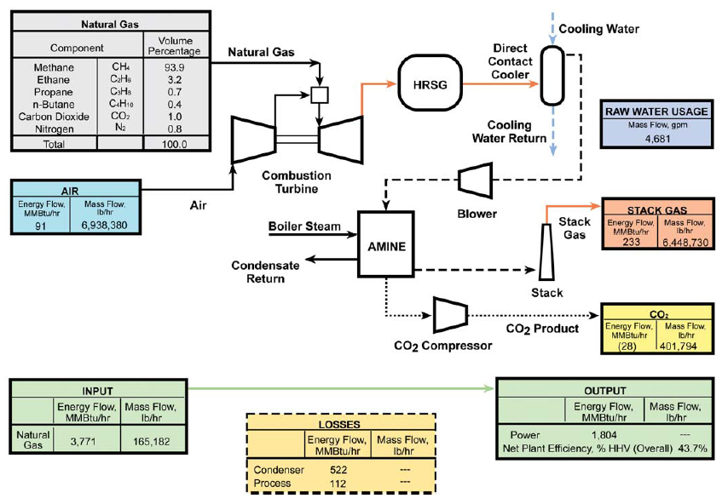
DOE Cost & Performance Comparison of Fossil Power Plants
DOE/NETL-2007/1281 (2007)

Slide 22
Model Predicts Higher Plant Efficiency and Lower COE for NGCC with HFMC
Basis | DOE |  | IECM
 | Case 13 | Case 14 | Base | Capture | Capture
CO₂ Capture Technology | No | Conv. Column | No | Conv. Column | HFMC
Gross Power Output (kW_{e}) | 570,200 | 520,900 | 516,840 | 516,840 | 516,840
Auxiliary Power Requirement (kW_{e}) | 9,840 | 38,200 | 10,340 | 84,540 | 55,000
Net Power Output (kW_{e}) | 560,360 | 481,890 | 506,500 | 432,300 | 461,900
Natural Gas Flowrate (lb/h) | 165,182 | 165,182 | 148,740 | 148,740 | 148,740
Net Plant HHV Efficiency (%) | 50.8 | 43.7 | 50.15 | 42.8 | 45.73
% Decrease in HHV Efficiency |  | 14.0 |  | 14.7 | 8.8
Net Plant HHV Heat Rate (Btu/kW-h) | 6,719 | 7,813 | 6,803 | 7,972 | 7,461
Total Plant Cost ($x1000) | 310,710 | 564,628 | 359,500 | 500,400 | 449,800
Total Plant Cost ($/kW) | 554 | 1,172 | 554 | 1,158 | 974
LCOE (mills/kWh) | 68.4 | 97.4 | 52.76 | 77.02 | 68.22
% Increase in LCOE (mills/kWh) |  | 42.4 |  | 46.0 | 29.3
CO₂ Emissions (lb/MWh) | 783 | 85.8 | 809.9 | 9.49 | 8.89
DOE/NETL-2007/1281 (2007)

Slide 23
HFMC Reduces Costs of CO₂ Capture
Improved membrane material and membrane performance to lower capital costs
Improved solvent regeneration using mild heat and higher pressure (even more when combined with a solvent requiring lower regeneration energy).
Improved process performance results from increased flexibility in solvent selection
Reduced system size and footprint by up to 70% enables retrofit application to many existing power plants
Reduced materials of construction costs since membrane modules are constructed from plastic materials and are not subject to corrosion
Reduced parasitic fan loads due to lower pressure and pressure drop requirements compared to conventional membranes and columns
Reduced solvent degradation

Slide 24
GTI Gratefully Acknowledge Support Provided by:
US Department of Energy, National Energy Technology Laboratory, under DOE Contract No. DE-FE0012829
Illinois Clean Coal Institute with funds made available by the State of Illinois
JIP Sponsors for the natural gas treating part of this work
Midwest Generation for hosting the post-combustion field experiment unit

