Slide 1
PAKISTAN POWER SECTOR
BACK-GROUND, PRESENT SITUATION
&
FUTURE PLANS

Slide 2
POWER SECTOR - BACKGROUND
WAPDA was formed in 1958. The major responsibilities of WAPDA were;
Meet electricity demand of the country (except area of Karachi) by installing new power plants, transmission lines and distribution system.
Develop hydro storage project ( dams) for meeting irrigation and demand of the country and install hydro plants at dams locations.

Slide 3
POWER SECTOR- BACKGROUND
POWER SECTOR - BACKGROUND
WAPDA Had Two Wings;
Power wing – Responsible for power matters
Water wing – Responsible for water matters
The WAPDA AUTHORITY consisted of;
Chairman
Member Power- Head of Power wing
Member Water – Head of Water wing
Member Finance – Head of Financial matters

Slide 4
POWER SECTOR - BACKGROUND
SECTIONS OF POWER WING WAPDA
Hydro Generation plants
Thermal Generation plants
Transmission lines and grid stations
Distribution network for consumers

Slide 5
POWER SECTOR - BACKGROUND
The GoP approved Pakistan Power Sector Strategic Plan for restructuring and reform in 1992.
PEPCO was established in 1998 as an independent entity with mandate to split Power wing of WAPDA into various entities and then corporatize & commercialize the restructured entities.
PEPCO initiated the restructuring and reform process in 1998. The reform process was considerably slowed down beyond 2001 when PEPCO was reduced to a Division in WAPDA.
The GoP reactivated the mandate of PEPCO in October 2007 to bridge the increasing demand supply gap and to reduce the resulting load shedding in the country
5. By the end of 2011, everybody was fed up with PEPCO, and now the restructured entities are being managed by the Ministry of Water & Power directly.
Notes:
5

Slide 6
PEPCO SYSTEM
Hydro Generation (Remains with WAPDA)
Thermal Generation 4 GENCOs
Transmission 1 NTDC
Distribution 10 DISCOs

Slide 7
Consumers vs Consumption Pattern
Consumers Category | No. of Consumers (As on 30th Jun 2013) |  | Consumption (Jul 2012 - Jun 2013)
 | Nos. | % age | Billion units | % age
Domestic | 18,713,537 | 85.55% | 33.258 | 51.18
Commercial | 2,550,808 | 11.66% | 4.657 | 7.17
Industrial | 296,849 | 1.36% | 19.172 | 29.5
Agricultural | 301,115 | 1.38% | 7.548 | 11.61
Others | 13,291 | 0.06% | 0.351 | 0.54
Total | 21,875,600 | 100.00% | 64.986 | 100.00%

Slide 8
Consumption Pattern Jul-2012 - Jun 2013

Slide 9
GENERATION SOURCES June 2013
1. HYDRO
WAPDA 6733
IPPS 195
Sub Total 6928
2. THERMAL
EX. WAPDA GENCOs 4785
IPPs 8359
NUCLEAR 650
Sub-Total 13794
GRAND TOTAL 20,722

Slide 10
Generation Sources (MW) June 2013

Slide 11
EXISTING GENERATING CAPABILITY (June, 2013)
Type of Generation | Nameplate/ Installed Capacity (MW) | Dependable Capacity (MW) | Availability (MW)
 |  |  | Summer | Winter
Hydro | 6928 | 6928 | 6928 | 2300*
GENCOs | 4785 | 3536 | 2736 | 3178**
IPPs (incl Nuclear) | 9009 | 8300 | 7000 | 7578**
Total | 20722 | 18764 | 16664 | 13056
* Hydro availability based on last 5 years average
** Excludes 10% Forced Outages for GENCOs & 6.0% for IPPs

Slide 12
VARIATION IN GENERATION MIX
YEAR | HYDEL GENERATION | THERMAL GENERATION
1994- 95 | 50 % | 50 % (Mostly on gas)
2000- 01 | 30 % | 70 %
2006- 07 | 36 % | 64 %
2012- 13 | 34 % | 66 % ( Mostly on oil)

Slide 13
Reasons For Price Hike Of Cost Of Electricity
Oil Prices are beyond control of Pakistan
Depletion of natural gas reserves
Non-conducive circumstances for foreign investments (national/regional instability)
Delay in exploitation of indigenous resources, i.e. Thar Coal in South and huge hydel potential in Northen Areas
Theft of Electricity

Slide 14
PEPCO SYSTEM HISTORICAL SURPLUS / DEFICIT
Years | Available Capability | Computed Peak Demand | Surplus/ Shortfall
2001-02 | 10894 | 10459 | 435
2002-03 | 10958 | 11044 | -86
2003-04 | 11834 | 11598 | 236
2004-05 | 12792 | 12595 | 197
2005-06 | 12600 | 13847 | -1247
2006-07 | 13292 | 15838 | -2546
2007-08 | 12442 | 17398 | -4956
2008-09 | 13637 | 17852 | -4215
2009-10 | 13445 | 18467 | -5022
2010-11 | 13193 | 18521 | -5328
2011-12 | 12320 | 18940 | -6620
2012-13 | 13577 | 18827 | -5250

Slide 15
Advance Caution Of Load Shedding/Short Fall
By
Planning Power WAPDA/NTDC In The Year 2000

Slide 16
Country wide Load Forecast of XWAPDA DISCOs’ & KESC (MW)
Year | XWAPDA DISCOs’ | KESC | Country
2011-12 | 19400 | 3021 | 22199
2012-13 | 20401 | 3240 | 23407
2013-14 | 21556 | 3484 | 24792
2014-15 | 22761 | 3762 | 26261
2015-16 | 24018 | 4157 | 27896
2016-17 | 25352 | 4592 | 29647
2017-18 | 26810 | 5067 | 31562
2018-19 | 28353 | 5587 | 33604
2019-20 | 30036 | 6144 | 35822
2020-21 | 31757 | 6752 | 38127
Note | Diversity Factor 1.01 is applied to get country demand
 | NTDC demand is PMS based prepared in March 2012
 | KESC demand is Regression Based prepared in January 2011

Slide 17
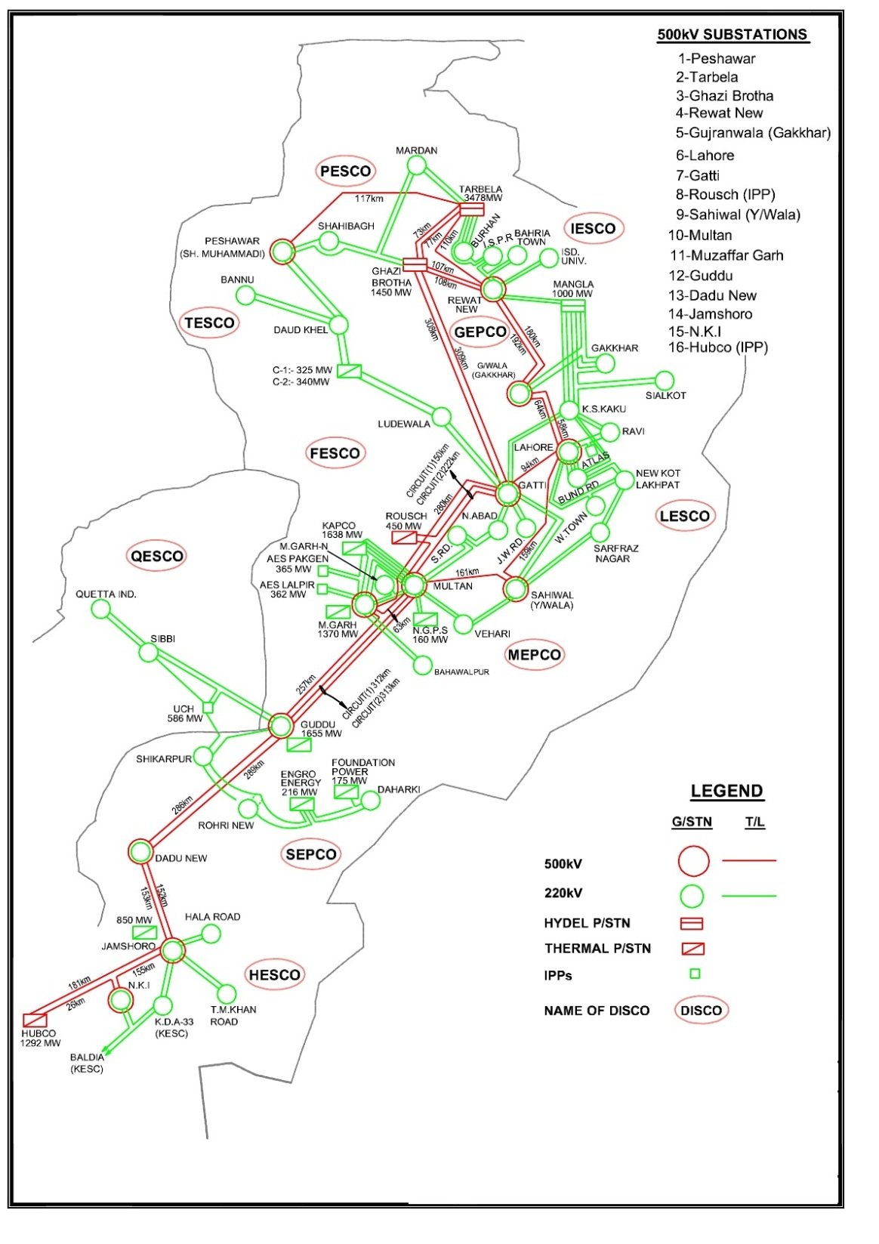
Existing Transmission Network of NTDC
500/220 kV Transformers (14,850 MVA)
220/132 kV Transformers (18,044 MVA)
500 kV Lines (5,078 km)
220 kV Lines (7,947 km)

Slide 18
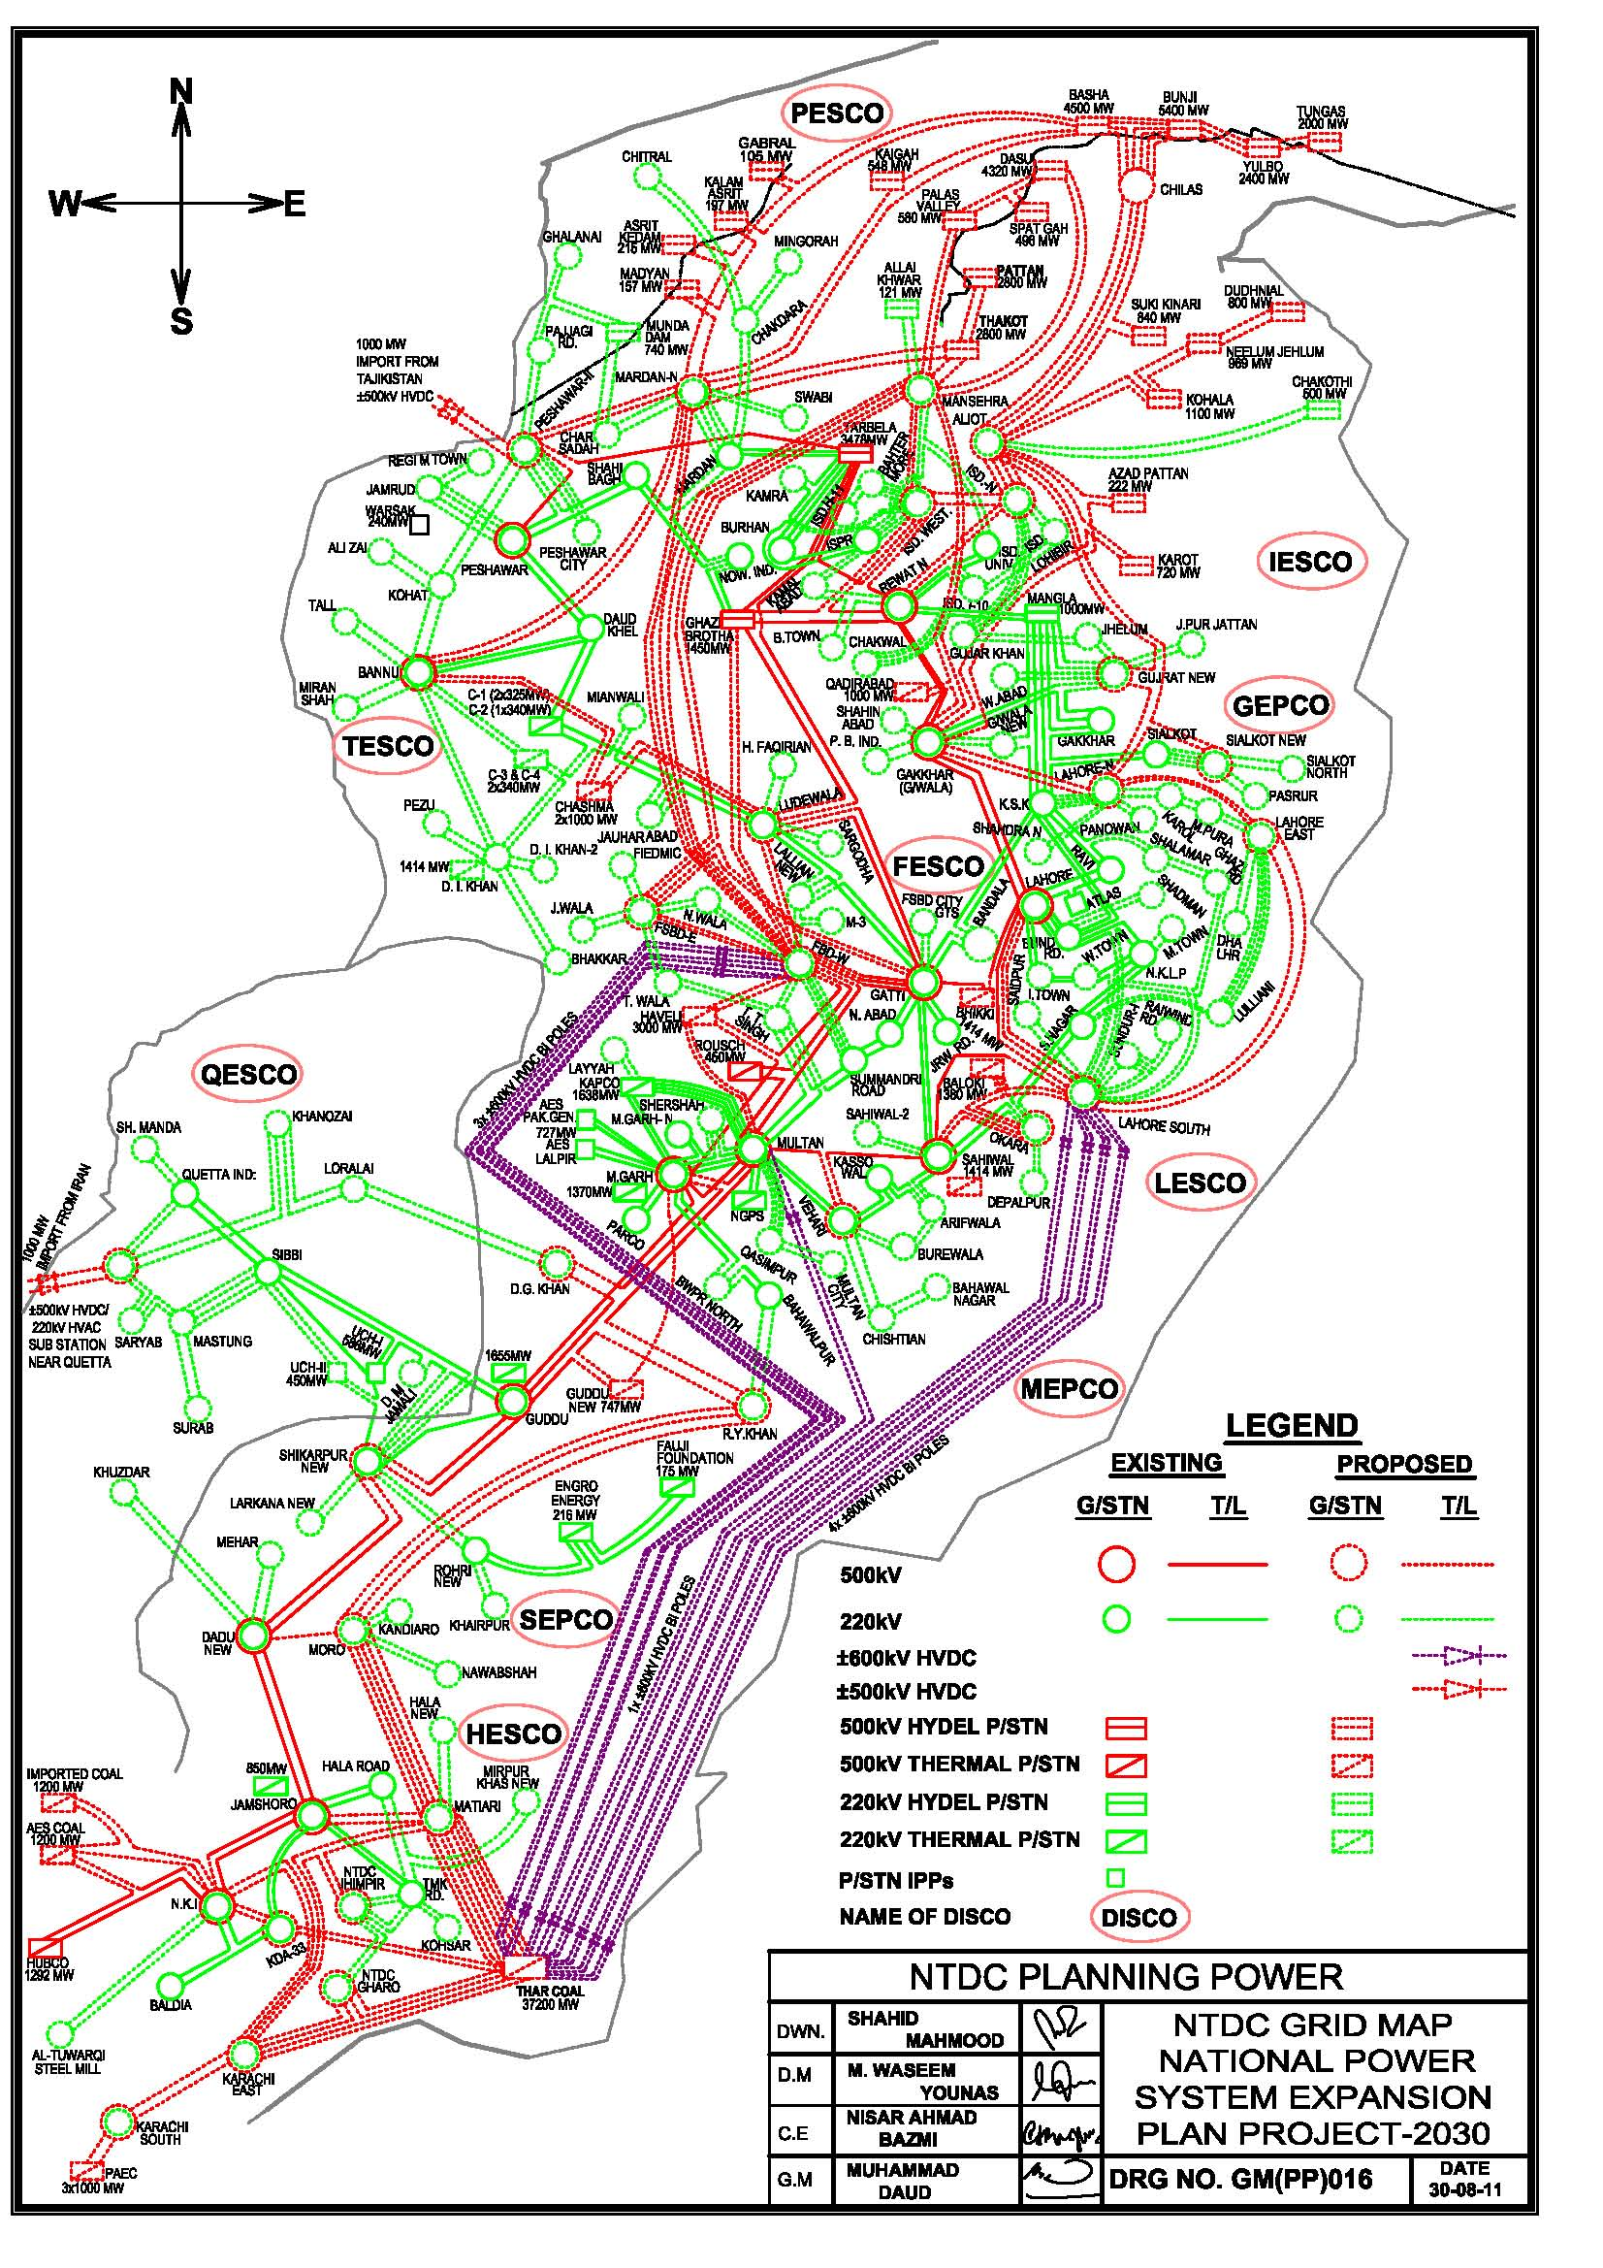

Slide 19
Long Term Transmission Expansion Plan
The proposed transmission expansion plan upto 2030 will be able to transmit about 90,000 MW power.

Slide 20
Comprehensiveness OF Transmission Expansion Plan
The Transmission Expansion Plan has been proposed to successfully and safely evacuate power from the mega hydel projects in the Northern areas and Thar Coal Power projects in the Southern part of the country.

Slide 21
Finances Required
“Huge Investment to the tune of about 280 Billion USD are required by 2030 for reliable Generation and Transmission Expansion to meet the Forecasted Electric Power Demand.”

Slide 22
Situation after June, 2013
The present government has some aggressive plans to install coal fired plants at Gadani Power Park and Bin Qasim Karachi to bridge the gap in supply and demand by the year 2017.
The success in implementation of the plans, however depends on how much conducive environment is created for foreign investment.

