Slide 1
AEP Perspectives on Development and Commercialization of CCS Technology for Natural Gas Power Generation
USEA Workshop on Technology Pathways
for CCS on Natural Gas Power Systems
April 22, 2014 – Washington, D.C.
Matt Usher, P.E.
Director – New Technology Development & Policy Support
mtusher@aep.com

Slide 2
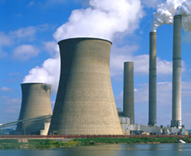
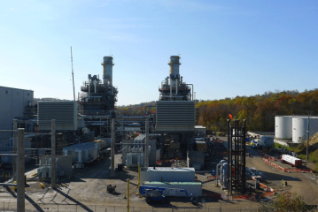
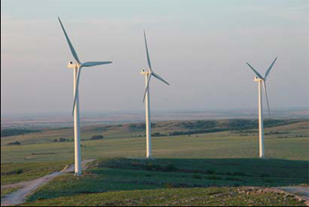
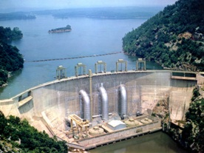
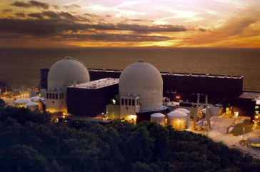
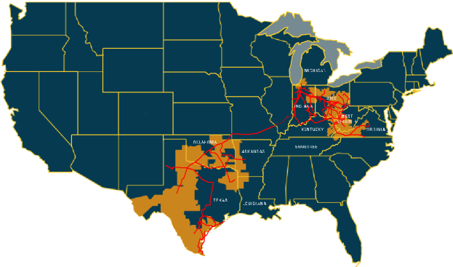
AEP Snapshot
Wind, Hydro, Solar & Pumped Storage
8%
Coal/Lignite
60%
Natural Gas
23%
Nuclear
5%
EE/DR
4%
AEP’s Operational Capacity
42,000+ MW
5.3 million customers in 11 states
Industry-leading size and scale of assets:
Industry
Asset
Size
Rank
Firm Generation
40,740 MW
# 4
Transmission
40,000 miles
# 1
Distribution
221,000 miles
# 2

Slide 3
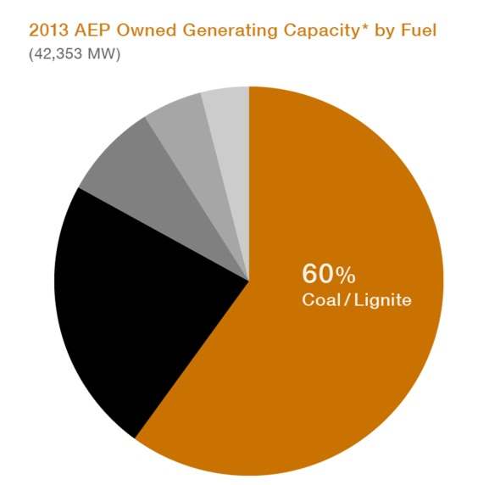
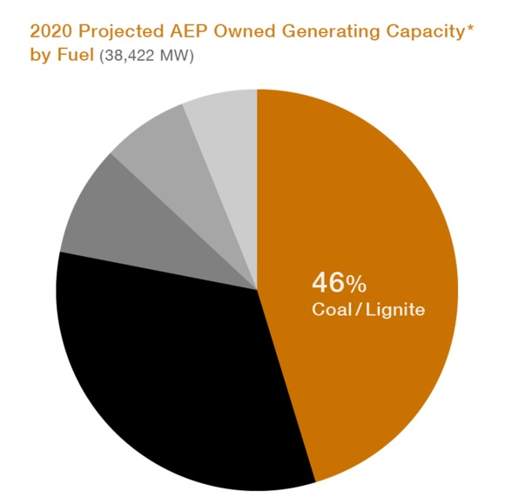
Fleet Transformation
2013
EPA Regulations
Coal Retirements
Increased Natural Gas Use
2020
AEP has added approximately 5,000 MW of new natural gas generation and over 2,000 MW of renewable generation to its portfolio over last 12 years.
AEP has reduced over 1,000MW of demand through energy efficiency & demand response programs over past 6 years.
By mid-2016 approximately 7,000 MW of coal-fueled generation will be retired
Gas refueling and new gas are two options to meet demand as coal units are retired.

Slide 4
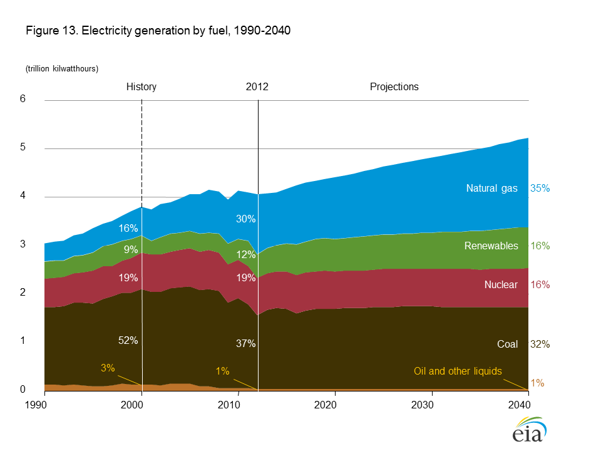
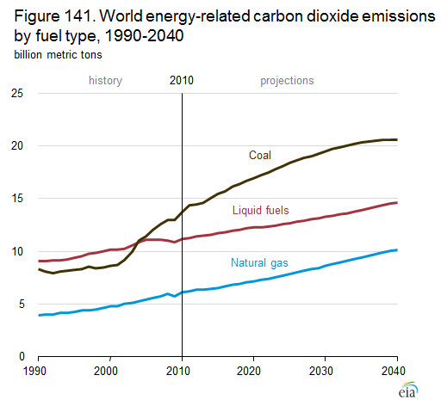
Coal’s Continued Usage in the U.S. and Abroad
EIA predicts that coal will continue to provide approximately 32% of U.S. electricity generation in 2040. While natural gas is predicted to own a larger share of generation (35%) in 2040, coal-based CCS would still have greater impact on CO₂ emissions reductions from the sector.
Global usage of coal for electricity generation will continue to rise (particularly in developing countries)
Shifting the focus away from coal diminishes potential for significant global CO₂ reductions

Slide 5
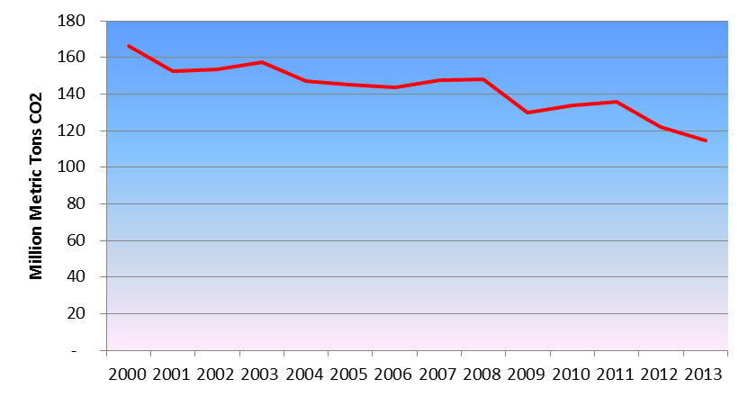
AEP CO₂ Emissions
AEP’s CO2 emissions have declined by ~21% since 2005 (~31% since 2000) and will likely decline by another 5+% by 2020 even absent CO2 regulations.

Slide 6
CO₂ Regulation on the Horizon
Sec. 111 (b) New Power Plants – re-proposed Sept. 2013 – requires new coal plants to be built with CCS. Effectively sets a “natural gas standard”
Sec. 111 (d) Existing Power Plants – proposed by June 2014 and then to be finalized by June 2015
ISSUES:
LEGAL – with 111(b) (‘adequately demonstrated’ CCS?) and potentially with 111(d) (“inside vs. outside the fence line”)
ECONOMIC – aggressive policy under 111(d) would be very expensive and force more coal retirements
POWER MARKETS – emerging concerns with power markets due to retirements and flawed capacity markets could be seriously exacerbated by an aggressive 111(d) rule
Current focus is on these issues and other pending regulations related to water, effluent, coal ash, etc. and their collective impacts on how we grow, maintain, and operate our fleet to provide reliable, secure, affordable energy.

Slide 7
Development & Commercialization of CCS for Natural Gas
To achieve the President’s goal of reducing GHG emissions by 80% (from 2005 levels) by 2050, it is likely that CO₂ reductions from natural gas power generation will one day become a reality.
Development of proactive R&D timelines and roadmaps between DOE/NETL, industry groups (USEA, ANGA, etc.) and technology providers is necessary
Moving too quickly could have negative results
No regulatory signals – GHG rules 111(b) and 111(d) are not even finalized yet to allow the industry to see the effects/impacts on environment, grid reliability, and economy.
“Regulation Fatigue”
Utilities are facing multiple pending/proposed regulations over a broad range of areas.
Further uncertainties surrounding potential fracking regulations (availability/price impacts)
CCS for natural gas will remain a low priority until the details/effects of these other regulations are better understood.
Little, if any interest for financial investment in pilot/commercial scale demos and willingness to assume those risks
To shift DOE and industry focus away from coal-based CCS too early poses a risk that technology innovation and demonstration where it is needed most to curb global CO₂ emissions will suffer.
U.S. OEMs moving toward natural gas CCS could threaten U.S./International collaboration on CCS technology as other countries are not as dependent upon natural gas.

